Slide 1

IMU-Based ACL impairment Assessment Using Machine Learning
19101207 Kim Taehyun

Slide 2
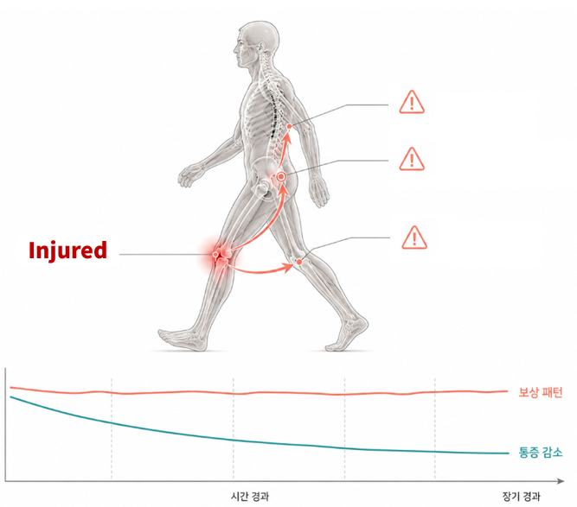
Why ACL?
250,000
Annual number of ACL surgeries in the United States
Up to 25%
Re-tear rate within 2 years
50%
Incidence of osteoarthritis within 15 years
Compensation
Pain level
Time

Slide 3
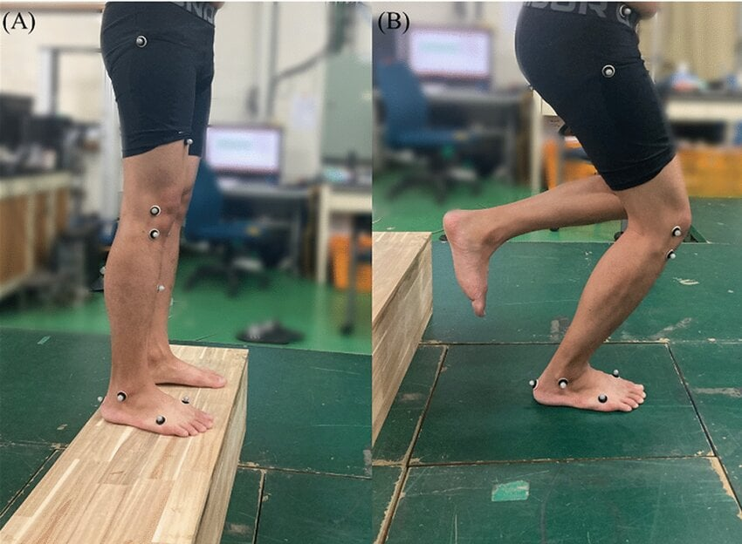
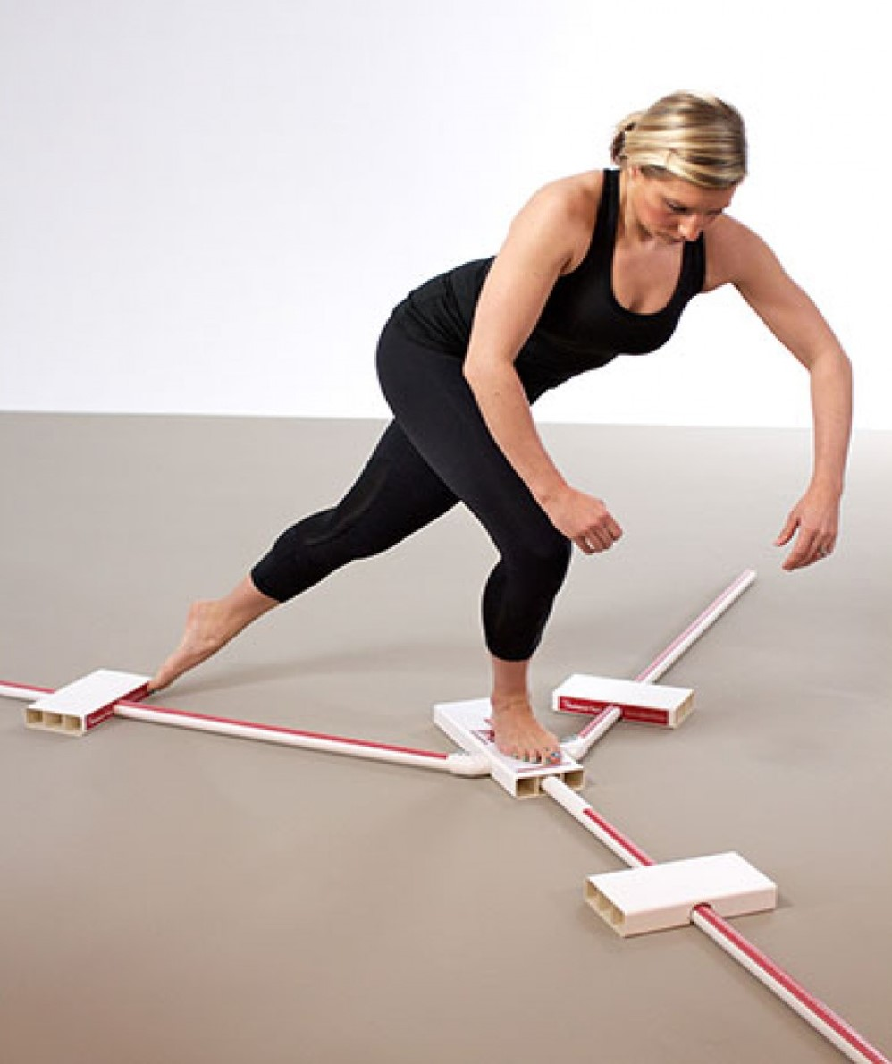
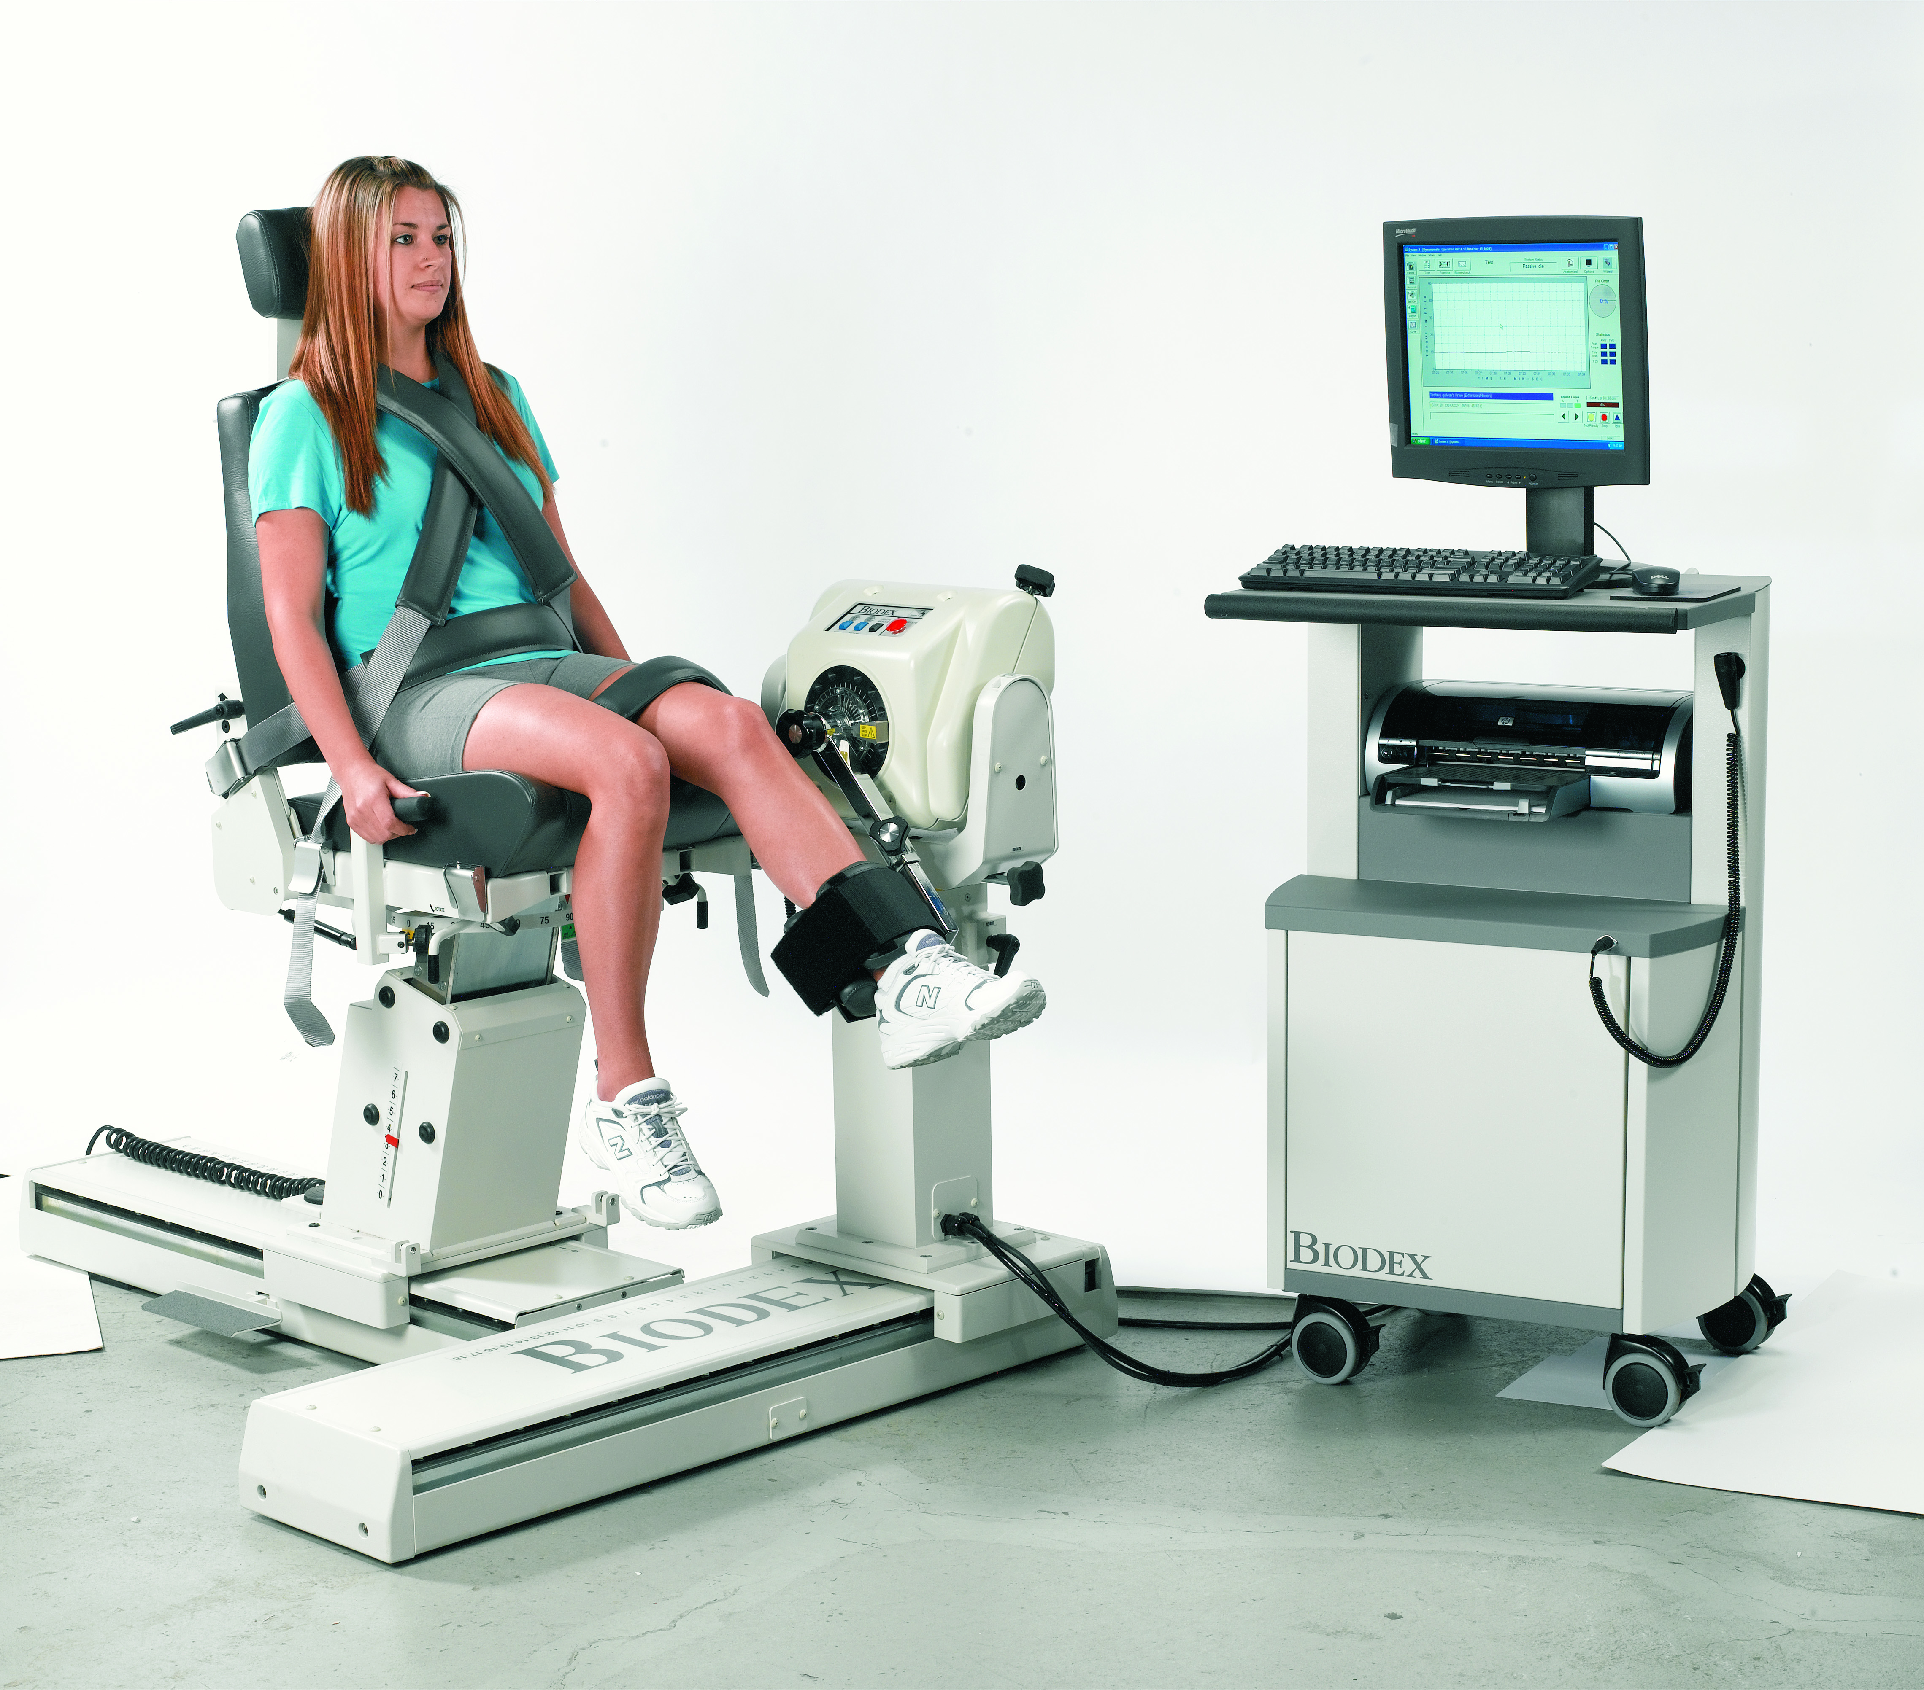
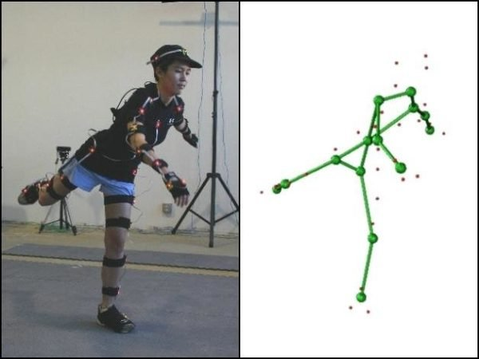



Why ACLD?
Current Assessment

Slide 4
Solution
What we need!
Gold Standard
Reliability
Clinical Assessment
COST

Slide 5
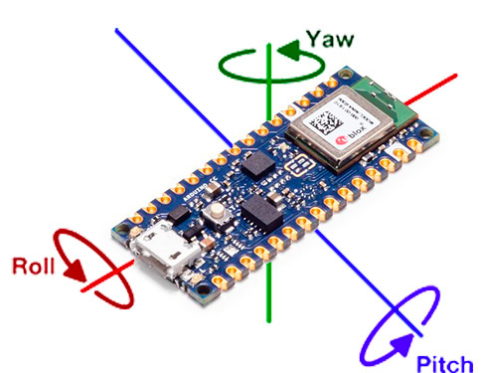
Solution
IMU
Cost
Size
Easy
GAIT
6,000–12,000 steps
Enables continuous monitoring in daily life Low intensity
Feasible for patients with minimal burden

Slide 6
Limitations of previous studies
Single-speed gait assessment
Use Only scalar features
High-cost laboratory environment

Slide 7
Our contribution
Early Rehabilitation
IMU- and ML-based Impairment Assessment
Multi-speed
Feasibility of Quantifying Assessment Outcomes

Slide 8
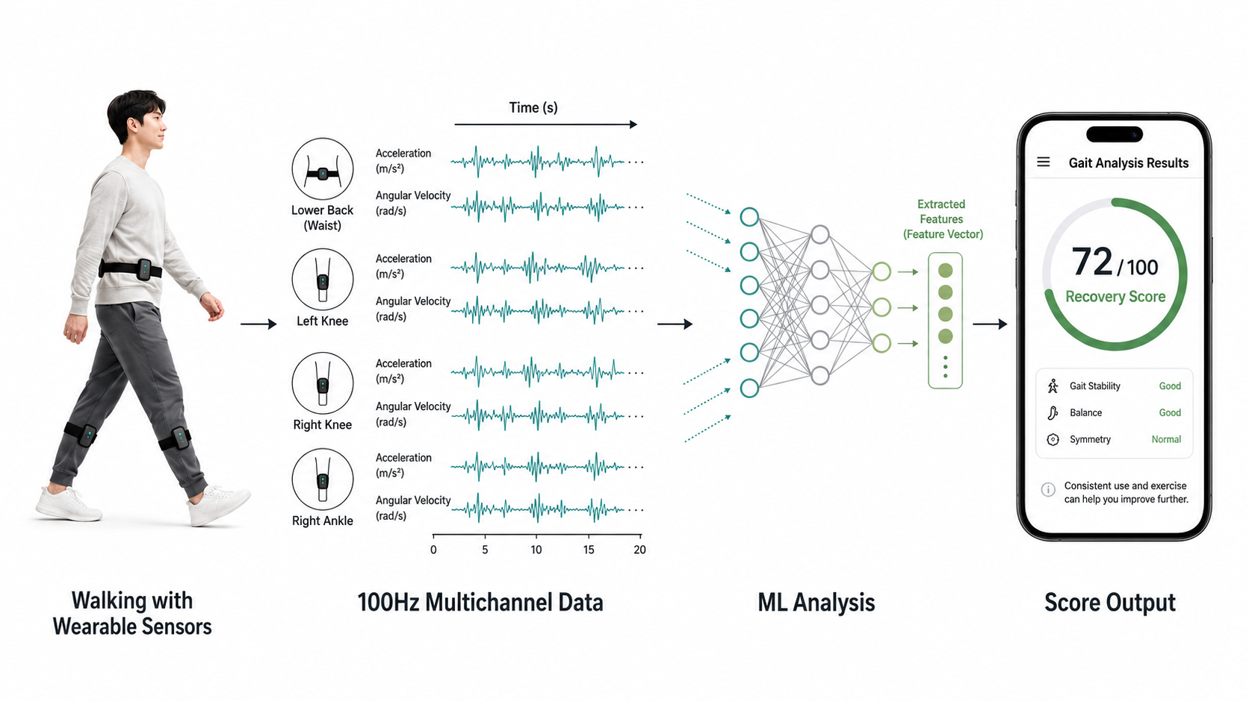
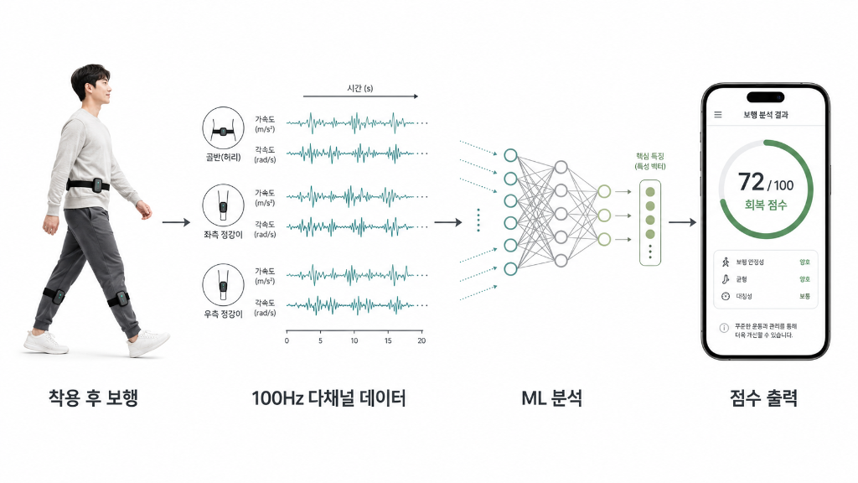
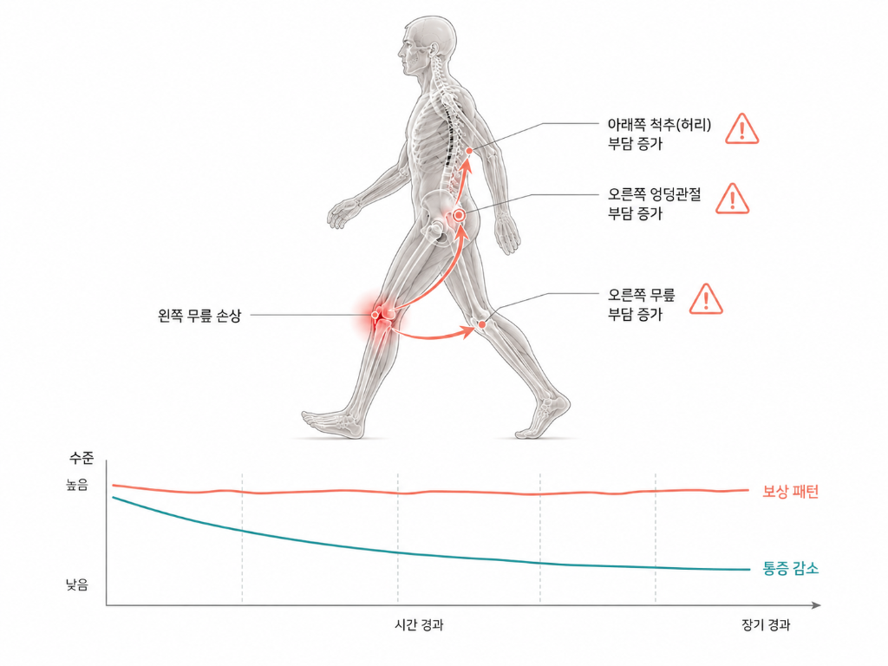

Slide 9
method
Data Preprocessing
Waveform Analysis
Impairment Scoring
SHAP Interpreting
Data inspection and normalization, peak detection
Global statistical analysis using SPM1D
Point Metric Analysis
Looking at biomechanical metrics and specific time point
Clustering, distance
Interpretation of ML using SHAP

Slide 10
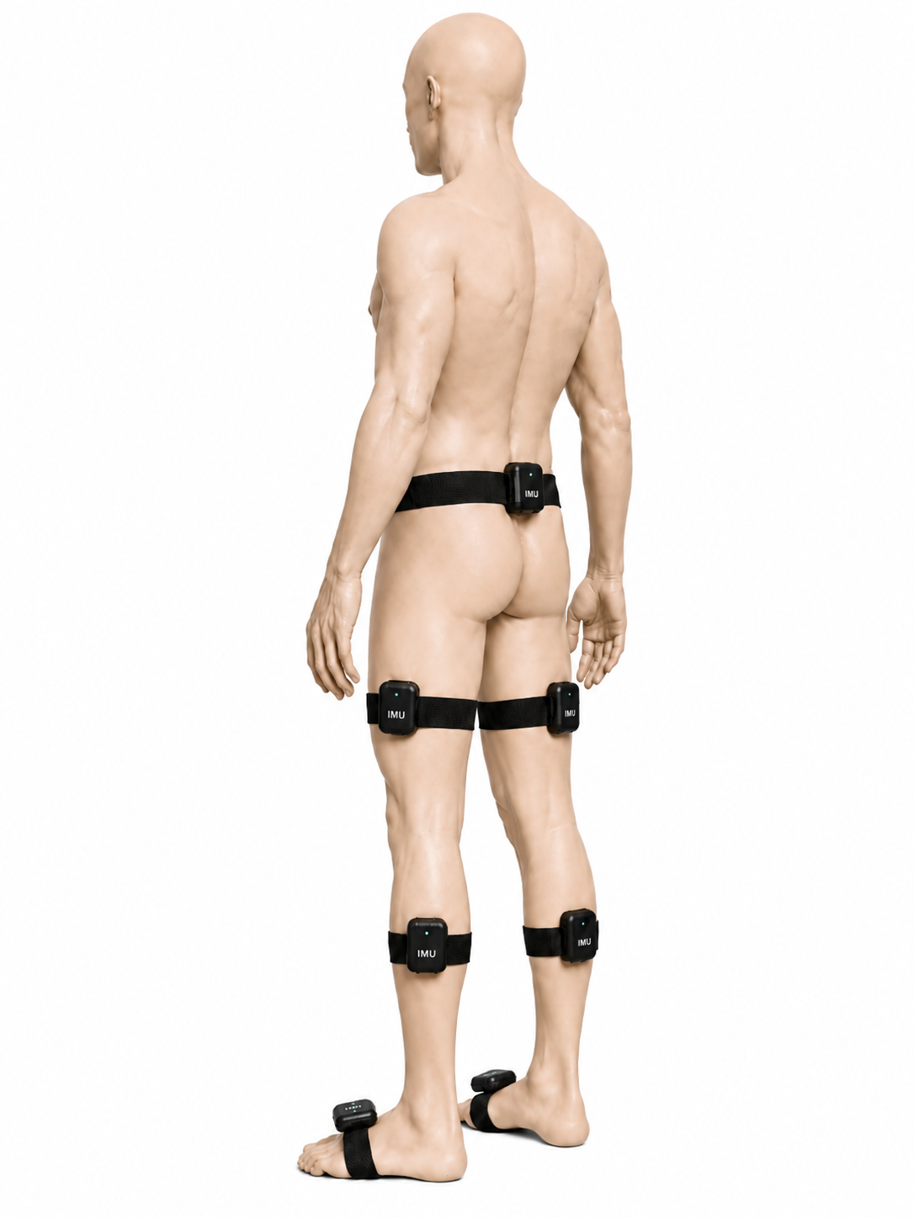
Data
Slow Normal Fast

Slide 11
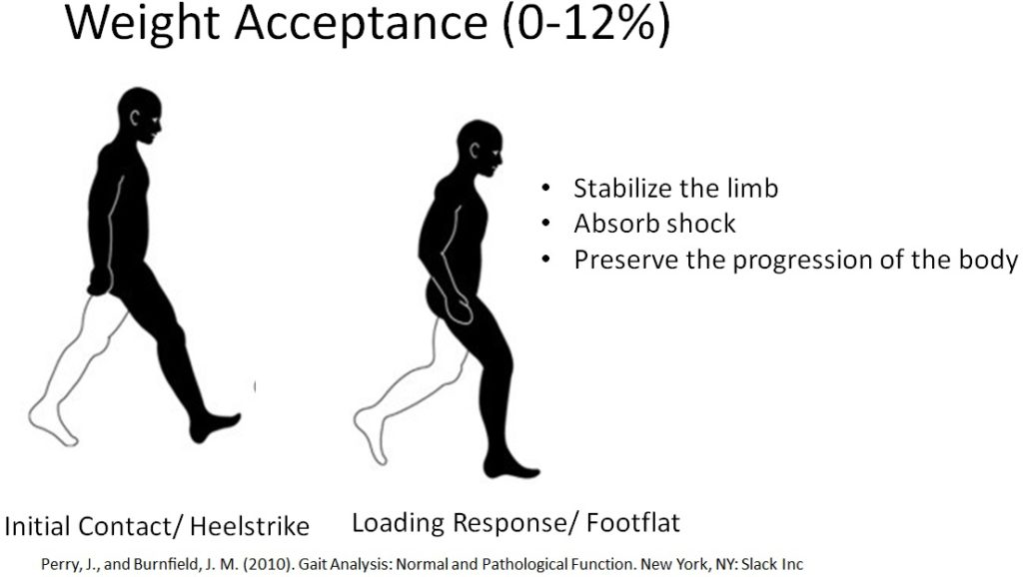
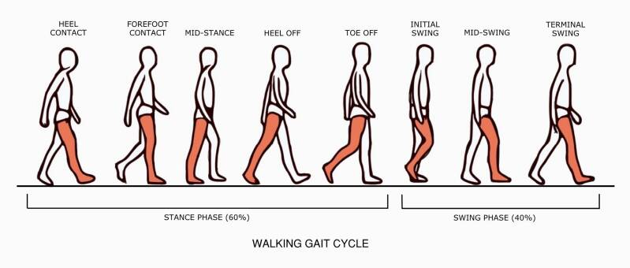
Biomechanical metrics
STANCE PHASE
SWING PHASE

Slide 12
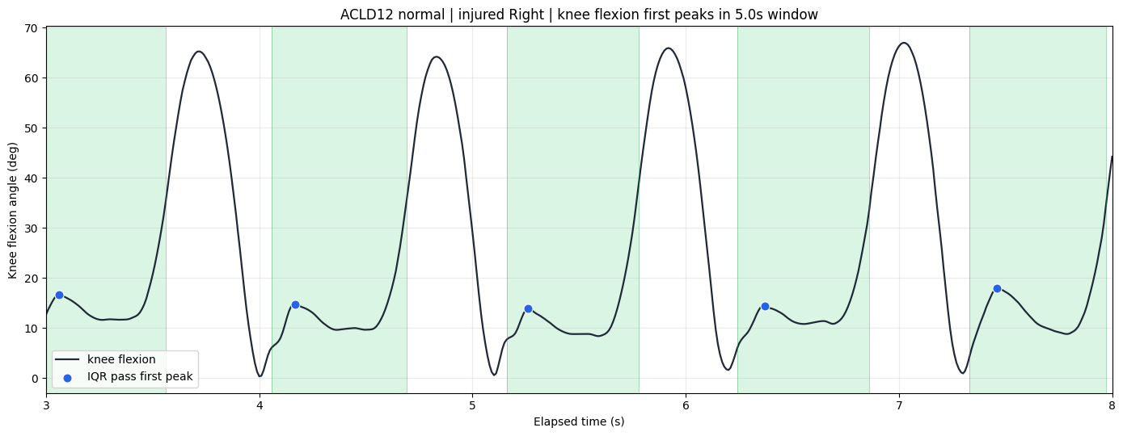
Biomechanical Features
Stance phase features
Peak / min / ROM / IC_angle / peak_timing
Limb Symmetry Index
( Injured / Contralateral ) X 100
Knee flexion angle
Time (s)

Slide 13
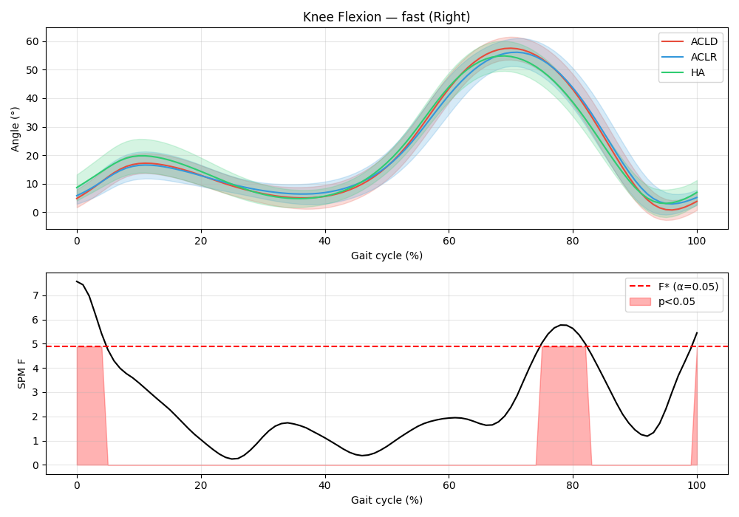
analysis
Point metric
Waveform, SPM1D
Scalar feature table
Shapiro-Wilk
Levene
Non-noraml
Normal + Equal var.
Normal + Unequal var.
Kruskal-Wallis
One-way ANOVA
Welch ANOVA
FDR-BH correction
Effect size
Downstream

Slide 14
Results summary
Significant features by speed
Significant features by cluster

Slide 15
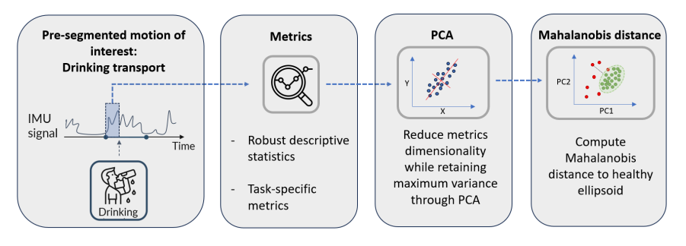
To do
Scoring Framework
Interpretation Using SHAP
SHAP was used to interpret the model’s predictions and improve explainability, which is crucial in medical applications.

Slide 16

Question?

Slide 17

Thank you for listening!

Slide 18



Why ML?
Input
Model
Output
Why ML?

